Slide 1
Nations and Nationalism
Lecture 4

Slide 2
What is nation?
Nation – the basic political unit since 1800s
Its achievements
In XXI c. – the diminishing role of the nation?
But what does this mean?

Slide 3
Issues to examine
What is a nation?
What is the difference between cultural and political nationalism?
How to explain the growth of nationalism in XIX-XX cc.
What political forms has nationalism assumed? Why?
What are the advantages of the nation-state?
Does the nation-state have future?

Slide 4
Nations and their emergence
Nation and social group – the latter means a group of people with social bonds and common interests
Nation and ethnic group – the latter is a community whose members share common cultural and historical identity (affinity of language, customs, religion, descent ) but lacks political consciousness and goals
Nation can be based on community of the language, religion, history, political consciousness – both objective and subjective factors
Example – the nations of Eastern Europe – former Polish-Lithuanian Commonwealth (Ist Polish Republic till 1795) – Poles dominanted but Lithuanians, Ukrainians and Byelarussians built up their own nations in XIX - XX c.

Slide 5
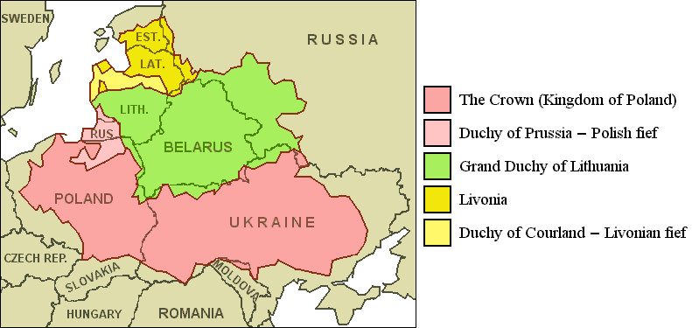
Polish-Lithuanian Commonwealth XVII c.

Slide 6
Nation – a definition
A complex social phenomenon – shaped by various cultural, political and psychological factors
Culturally – a community of language, traditions, history, customs, moral values
Politically – natural political community based on shared political values and loyalties with distinctive civic consciousness leading to establishment of its own nation-state or political autonomy
Psychologically – a group distinguished by affection to their community (patriotism)
Cultural and political nations

Slide 7
Cultural nations
Nation as cultural community – „Volksgeist” (the spirit of the people) Johann Gottfried Herder (1744-1803) – based on ethnicity
Culturalism – nations are „natural” (organic) entities – in past and future
Nation – response to people’s needs (security, identity and belonging - modern social psychologists)
Nation – a religion of modernity – gives ideological and emotional bonds to people living in new conditions of capitalism
Friedrich Meinecke – „cultural nations” – strong sense of national unity; reverence for the culture of a nation with its artefacts, creators (artists) and values („moral code”) – e.g. Poles in XIX c.

Slide 8
Political nations
Stress upon shared citizenship and political allegiances
Political nation – a group of people bound together by political values than common culture
Many theories of the political nation – Eric Hobsbawm – nations are created not by shared cultural values but invented by nationalist ideology („imagined community”)
Political elites create the phenomenon – intelligentsia
Examples – the USA, the UK, France – nations build around certain values, interests and goals – the political nations do not appeal to emotions
Developing states – quest for national liberation and freedom (Africa) – national identity. Third world nations – anticolonial identity, building nations on the basis of existing post-colonial states (artificially created) – result in often instability, conflicts and domestic violence

Slide 9
Nationalism (-s)
This is an ideology that takes the nation to be the central principle of political organization. It has got central political importance. It also puts the interests of the nation in the first plan even to the detriment of other nations („national selfishness”). The latter are to be treated suspiciously as they create competition that could undermine the position of the nation.

Slide 10
Specificity of nationalism
Nationalism – a complex phenomenon. Positive or negative?
Nationalism – linked with other ideals and ideologies („cross-cutting” ideology)
Four types of nationalism:
Liberal nationalism
Conservative nationalism
Expansionist nationalism
Anticolonial nationalism

Slide 11
Liberal nationalism
Liberal nationalism – a universal right to self-determination
In XIXth c. – meant the struggle for freedom, independence, civic rights, limited and constitutional government (the 1848 Revolution)
Liberal nationalism’s apostles: Giuseppe Mazzini („Young Europe”); Simon Boivar (Latin America) and Woodrow Wilson’s „Fourteen Points” (1918)
National self-determination – the main principle leading to construction a nation-state
It proclaims equality of rights of all nations respecting their freedom and sovereignty – but claims for controlling nation-states by supranational bodies to protect individuals’ human rights and respect for universal values
It is for enlarging the scope of political freedom (e.g. The Versailles Treaty – 1919)
Disadvantages of liberal nationalism – naivety and promoting national rivalry (Yugoslavia)

Slide 12
Conservative nationalism
Conservative nationalism values the capacity of national patriotism - it delivers social cohesion and national unity
Patriotism – emotional attachment to one’s nation and country
Nationalism vs patriotism – a nationalist is always a patriot but a patriot does not have to be a nationalist
XIX c. – nationalism treated with suspicion by conservatists (too revolutionary)
Treated instrumentally by conservative leaders: Bismarck, Tsar Alexander III etc.
In XX c. cherished by famous conservatives e. g. Margaret Thatcher, Ronald Reagan
Conservatism’s ally – delivers social cohesion and help maintain public order
- Seen as rooted in the past traditions that turns nationalism into defence traditional values.
Resembles traditionalism - becomes nostalgic and backward-looking (USA – Pilgrim Fathers, War of Independence; in the UK – the monarchy
Popular in established nation-states that are afraid of foreign influence and internal enemies (e. g. imigrants)
-Instrumentally treated by leaders and elites („nationalism card”)
- criticised for promoting insular and intolerant nationalism based upon the concept of nation as an exclusive community (like extended family)
- may promote racism and xenophobia

Slide 13
Expansionist nationalism
Antithesis of liberal nationalism – against nations’ self-determination
Agressive, militaristic – XIX c. European imperialism in Africa
Integral nationalism – fanatical approach - nation first, individual means nothing outside a nation, must be subordinated to it
It rejects democracy – as a source of weakness – monarchical absolutism better
Leads to chauvinism – fanatical belief of superiority over other groups or nations e. g. anti-semitism
Expansionist nationalism – draws upon myths of national greatness (Mussolini’s „Imperial Rome”; Hitler’s „First and Second Reich”)
Pan-nationalism – unifying disparate people through expansionism

Slide 14
Anticolonial nationalism
Linked nationalism with the fight of nations or nations-in-the-making against colonial powers making use of European ideas and conceptions
Popularised nationalism invented in Europe all over the world
Help forge a sense of nationhood – striving for „national liberation”
IInd half of XX c. – decolonization era – emergence of new states
Self-determinantion fused with the quest for social development
Political and economic liberation from Western domination
Socialism popular – it resembled pre-industrial values of Africans
Marxism helped liberate from under Western exploitation
Religious (islamic) fundamentalism – a new form of politics – deeply differentiated across Asia and Africa

Slide 15
Recapitulation
Nation is a community based upon affinity of culture, history, tradition and political awarness
There are cultural and political nations i. e. created around cultural or political values
Nationalism is an ideology that prioritizes the interest of the nation even to the detriment of other similar communities
There are four main types of nationalism: liberal, conservative, expansionist and anticolonial

